Slide 1


AIML PRESENTATION ON IMAGE CLASSIFIER
Submitted by :
Aryan(2210990174)

Slide 2
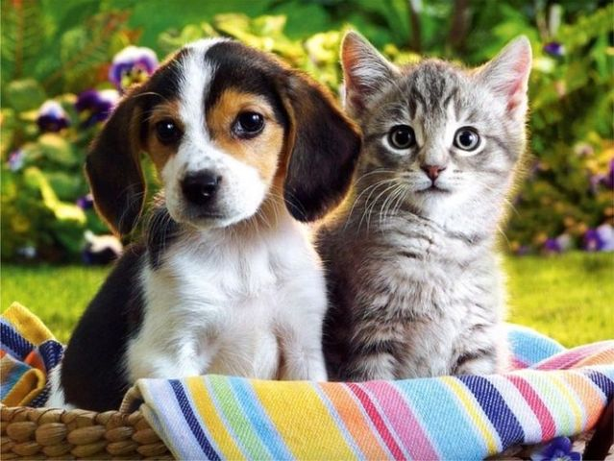
CONTENTS
INTRODUCTION
PROBLEM STATEMENT
REQUIRNMENTS
VISUALISATION
LIBRARIES IMPORTED
EXPLORATORY DATA ANALSIS
RESULTS

Slide 3

INTRODUCTION
This project basically helps in identification of an image whether it’s a CAT or DOG. Machine Learning (ML) and Artificial Intelligence (AI) techniques can be leveraged to predict the identification or classification of an image .

Slide 4
PROJECT SCOPE
The project encompasses data preprocessing, exploratory data analysis (EDA), feature engineering, and model building stages. Multiple machine learning techniques such as logistic regression are employed and evaluated to develop an accurate predictive model. The project aims to help user for the classification of given animal.

Slide 5
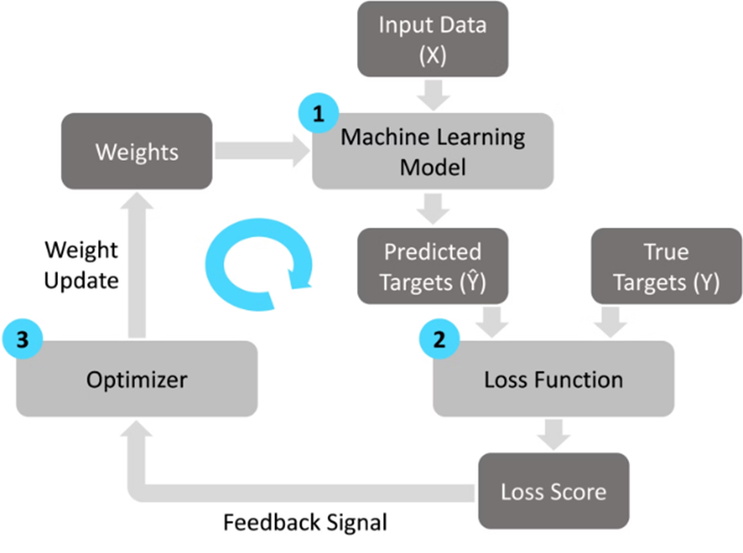
REquirements
The project requires:
A comprehensive dataset of patients listings with attributes like age, sex, etc.
Knowledge of AIML for creating conversational interfaces.
Familiarity with machine learning techniques for data preprocessing, model training, and evaluation.
Access to computational resources for model development and deployment.
Expertise in software engineering for system integration and scalability.

Slide 6

LIBRARIES IMPORTED
The Libraries imported are :
import pandas as pd
import numpy as np
import train_test_split
import LogisticRegression
import accuracy_score

Slide 7
REferences
PyPl.org
GeeksforGeeks
Youtube

Slide 8
THANK YOU

